Slide 1
Neural Network Basics
Perceptron and other animal species

Slide 2
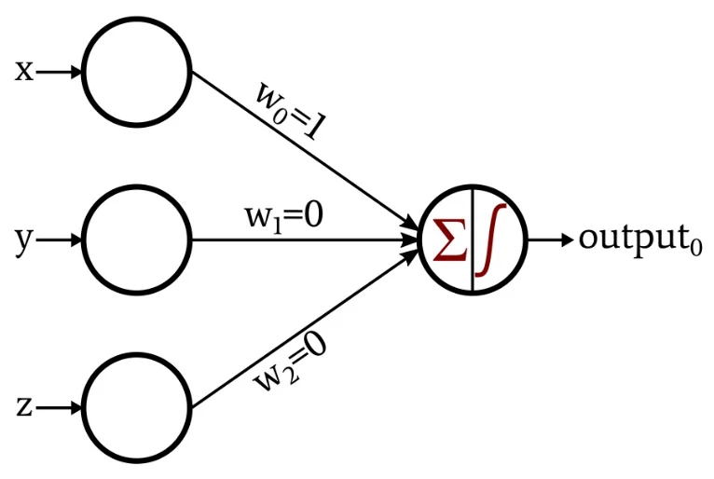
Perceptron
Input data
Weights
Sum of the multiplication data and weights
Activation function
Bias is a value which corrects

Slide 3
How does it work
We need dataset (huge amount of data)
Separate into 3 parts (learning, testing, using)
How do I solve when there is no numerical data?
Make a loop where give a data row to the network
The network will give a guess
Calculate the error rate
Calculate weights
Try again

Slide 4
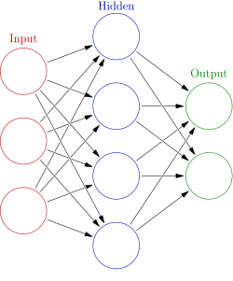
What is the neural network
Perceptrons which connected to each other
Columns are the layers
Hidden layer can called as deep layer (deep learning)
Hidden layer can have more than one

Slide 5
Back propagation method
Don't panic, take a deep breath, relax.
We will derive.

Slide 6
Activation function
The activation function of a node in an artificial neural network is a function that calculates the output of the node based on its individual inputs and their weights
https://en.wikipedia.org/wiki/Activation_function

Slide 7
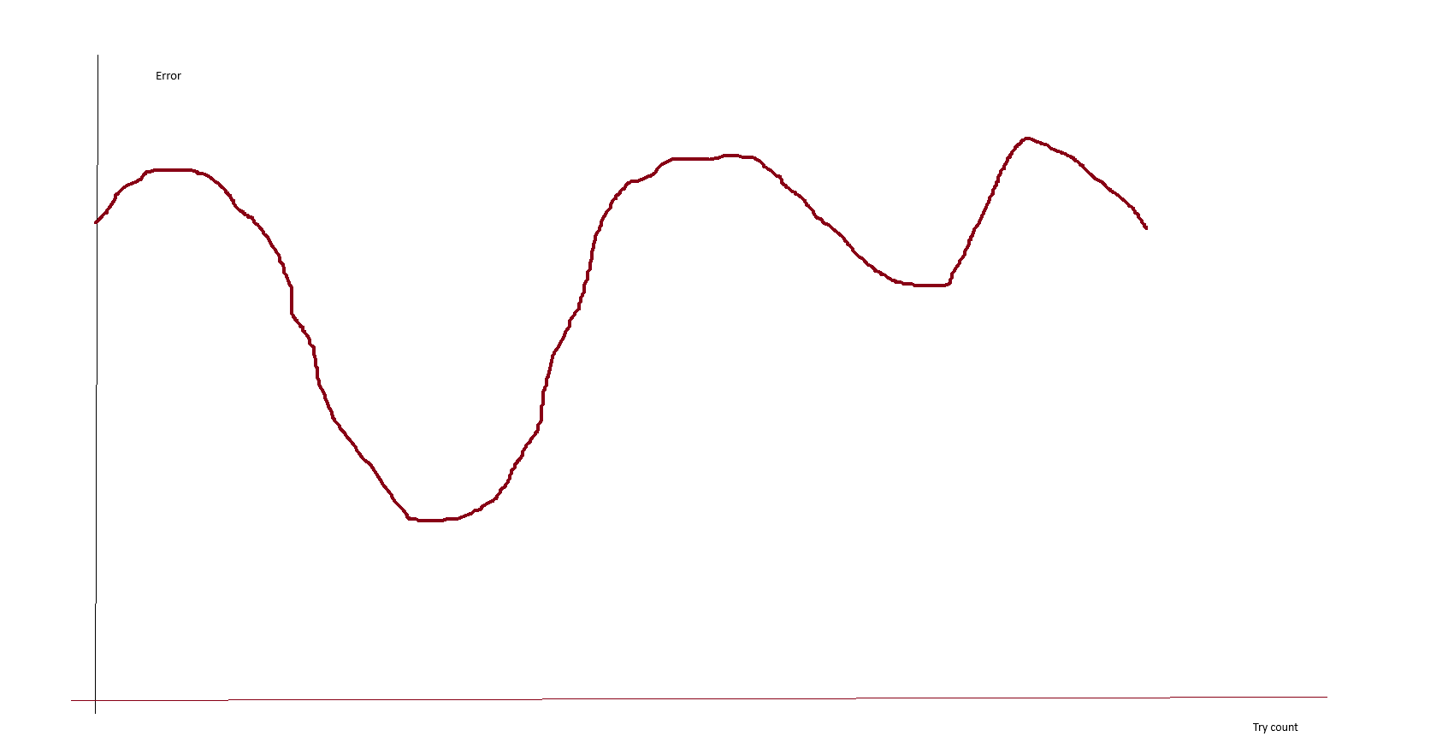
Learning curve

Slide 8
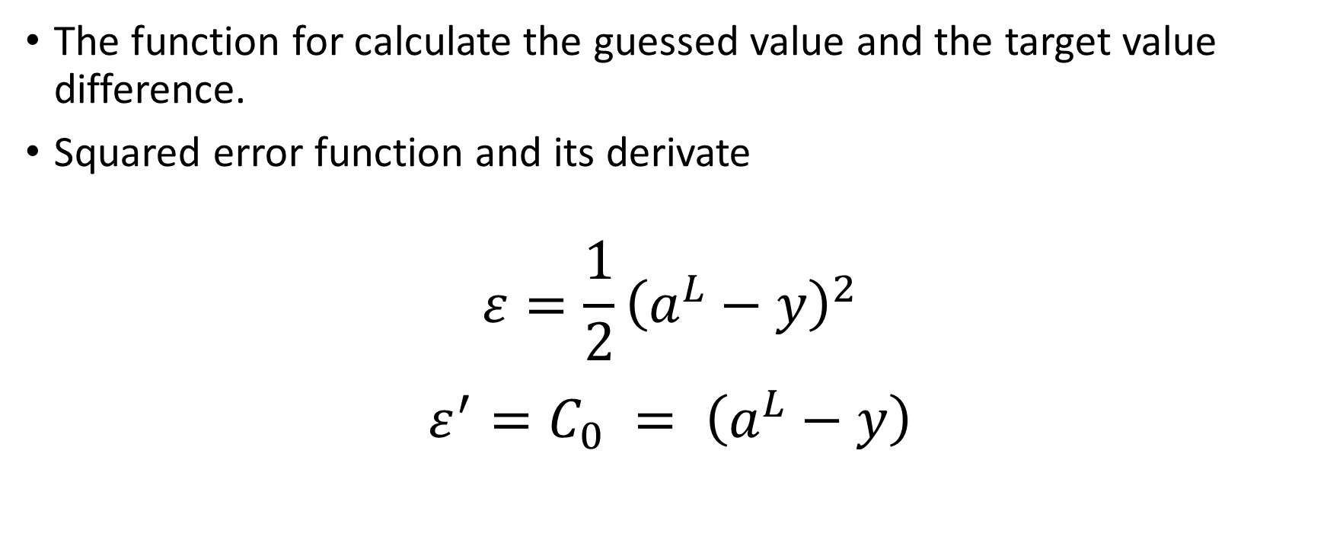
Error functions
The function for calculate the guessed value and the target value difference.
Squared error function and its derivate
$$ε=\frac{1}{2}{\left(a^{L}−y\right)}^{2}$$
$${ε^{′}=C}_{0} = \left(a^{L}−y\right)$$

Slide 9

Perceptron
Multiplied sum of the weights and inputs $z^{L}= w^{L}a^{L−1}+b^{L}$
Output $a^{L}=σ\left(z^{L}\right)$
Activation and its derivate $σ=\frac{1}{1+e^{x}}$
$$σ^{′}=1−x$$

Slide 10

The weights calculation partial derivates
$$\frac{∂C_{0}}{∂w^{L}}= \frac{∂z^{L}}{∂w^{L}} \frac{∂a^{L}}{∂z^{L}} \frac{∂C_{0}}{∂a^{L}}$$
$$\frac{∂C_{0}}{∂a^{L}}=2\left(a^{L}−y\right)$$
$$\frac{∂a^{L}}{∂z^{L}}=σ′(z^{L})$$
$$\frac{∂z^{L}}{∂w^{L}}=a^{L−1}$$

Slide 11
The values referred to error
$$\frac{∂C_{0}}{∂w^{L}}= \frac{∂z^{L}}{∂w^{L}} \frac{∂a^{L}}{∂z^{L}} \frac{∂C_{0}}{∂a^{L}}$$
$$\frac{∂C_{0}}{∂a^{L}}=2\left(a^{L}−y\right)$$
$$\frac{∂a^{L}}{∂z^{L}}=σ′(z^{L})$$
$$\frac{∂z^{L}}{∂w^{L}}=a^{L−1}$$

Slide 12

Next time we will create a perceptron

